Slide 1

Personal and Organizational Ethics
0
Chapter 8
Prepared by Deborah Baker
Texas Christian University
Business and Society: Ethics and Stakeholder Management, 7e • Carroll & Buchholtz
Copyright ©2009 by South-Western, a division of Cengage Learning. All rights reserved

Slide 2
Chapter 8 Learning Outcomes
0
Understand the different levels at which business ethics may be addressed.
Differentiate between consequence-based and
duty-based principles of ethics.
Enumerate and discuss principles of personal ethical decision making and ethical tests for screening ethical decisions.
Identify the factors affecting an organization’s moral climate and provide examples.
Describe and explain actions, strategies, or “best practices” to improve an organization’s ethical climate.

Slide 3
Chapter 8 Outline
0
Levels at Which Ethics May Be Addressed
Personal and Managerial Ethics
Managing Organizational Ethics
From Moral Decisions to Moral Organizations
Summary
Key Terms
Discussion Questions
Notes:
Chapter 8
Personal and Organizational Ethics
Levels at Which Ethical Issues May Be Addressed
Personal Level
Organizational Level
Industry Level
Societal and International Levels
Personal and Managerial Ethics
Principles Approach to Ethics
Ethical Tests Approach
Managing Organizational Ethics
Factors Affecting the Organization’s Moral Climate
Improving the Organization’s Ethical Climate
Summary

Slide 4
Introduction to Chapter 8
0
This chapter focuses on the day-to-day ethical issues that managers face
Many managers have no training in business ethics or ethical decision making
Ethics is vital to business success

Slide 5
Levels at Which Ethical Issues
May Be Addressed
Situations faced in our personal
lives outside the work context
0
Personal
Level
Workplace situations faced as
managers and employees
Organizational
Level

Slide 6
Levels at Which Ethical Issues
May Be Addressed
Situations where a manager or
organization might influence
business ethics at the industry level
0
Industry
Level
Local-to-global situations
confronted indirectly as a
management team
Societal and
Global Levels

Slide 7
Personal and Managerial Ethics
0
Conventional approach
Resolving
Ethical
Conflicts
Principles approach
Ethical tests approach

Slide 8
Types of Ethical Principles
Focus on the consequences or
results of the actions they produce
0
Teleological
Theories
Focus on duties
Deontological
Theories
Focus on virtue
Aretaic
Theories

Slide 9
Principles Approach to Ethics
0
Major Principles of Ethics
Utilitarianism
Rights
Justice
Care
Virtue ethics
Servant leadership
Golden Rule

Slide 10
Principle of Utilitarianism
0
Utilitarianism focuses on acts that produce the
greatest ratio of good to evil for everyone
Strengths
Weaknesses
Forces thinking about the
general welfare and
stakeholders
Allows personal decisions to fit
into the situation complexities
Ignores actions that may be
inherently wrong
May come into conflict with
the idea of justice
Difficult to formulate satisfactory
rules for decision making

Slide 11
Kant’s Categorical Imperative
0
Kant’s Categorical Imperative is a duty-based principle of ethics. A sense of duty arises from reason
or rational nature.
Formulations
Act only on rules that you would be willing to see
everyone follow.
Act to treat humanity in every case as an end and
never as a means.
Every rational being is able to regard oneself as a maker
of universal law. We do not need an external authority
to determine the nature of the moral law.

Slide 12
Principle of Rights
0
Principle of Rights focuses on examining and possibly protecting individual moral or legal rights

Slide 13
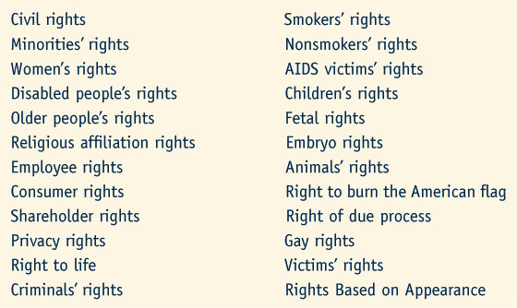
Principle of Rights
0
Figure 8-1

Slide 14
Principle of Justice
0
Principle of justice involves considering what alternative
promotes fair treatment of people
Types of justice
  Distributive
  Compensatory
  Procedural
  Rawlsian

Slide 15
Ethical Due Process
0
Process Fairness
Have employees been given input into the decision process?
Do employees believe the decisions were made and implemented in an appropriate manner?
Do managers provide explanations when asked? Do they treat others respectfully? Do they listen to comments being made?

Slide 16
Rawls’s Principles of Justice
0
Each person has an equal right to the most basic liberties compatible with similar liberties for others
Social and economic inequalities are arranged so that they are both:
  reasonably expected to be to everyone’s advantage and
  attached to positions and offices open to all

Slide 17
Ethic of Care and Virtue Ethics
0
Principle of caring focuses on a person as a relational (cooperative) and not as an individual
  Feminist theory
Virtue ethics focuses on individuals becoming
imbued with virtues
  Aristotle and Plato

Slide 18
Servant Leadership
0
Servant leadership focuses on serving others
first, such as employees, customers, and community

Slide 19

Servant Leadership
0
Characteristics of Servant Leaders
Listening
Empathy
Healing
Persuasion
Awareness
Foresight
Conceptualization
Commitment to the growth of people
Stewardship
Building community
Bridges
Business Ethics
and
Leadership

Slide 20
The Golden Rule
0
The Golden Rule focuses on the premise
that you should do unto others as
you would have them do unto you
The Golden Rule is…
accepted by most people
easy to understand
a win-win philosophy
a compass when you need direction

Slide 21
Ethical Principles
0
The Categorical Imperative
The Conventionalist Ethic
The Disclosure Rule
The Golden Rule
The Hedonistic Ethic
The Intuition Ethic
The Market Ethic
The Means-Ends Ethic
The Might-Equals-Right Ethic
The Organization Ethic
The Professional Ethic
The Proportionality Principle
The Revelation Ethic
The Utilitarian Ethic
Figure 8-2

Slide 22
Reconciling Ethical Conflicts
0
Concerns to be Addressed in Ethical Conflicts
Obligations
Ideals
Effects

Slide 23
Guidelines for Conflicting
Obligations, Ideals, and Effects
0
When two or more moral obligations conflict,
choose the stronger one
When two or more ideals conflict, or when ideals conflict with obligations, honor the more important one
When effects are mixed, choose the action that produces the greater good or less harm

Slide 24
Ethical Tests Approach
0
Test of Common Sense
Test of One’s Best Self
Test of Making Something Public
Test of Ventilation
Test of the Purified Idea
Big Four (greed, speed, laziness, or haziness)
Gag Test

Slide 25
Factors Affecting the
Morality of Managers
0
Society’s Moral Climate
Business’s Moral Climate
Industry’s Moral Climate
Organization’s Moral Climate
Superiors
Individual
One’s Personal
Situation
Policies
Peers
Figure 8-4

Slide 26
Factors Affecting the
Organization’s Moral Climate
0
Behavior of superiors
Behavior of one’s peers in the organization
Ethical practices of one’s industry or profession
Society’s moral climate
Formal organizational policy (or lack of one)
Personal financial need
Figure 8-5

Slide 27
Pressures Exerted on Employees by Superiors
0
Managers feel under pressure to compromise
personal standards to achieve company goals.
Top management: 50 percent agreed
Middle management: 65 percent agreed
Lower management: 85 percent agreed

Slide 28
Questionable Organizational Climates
0
Questionable Behaviors of Superiors or Peers
Unethical acts, behaviors or practices
Acceptance or legality as a standard of behavior
Bottom-line mentality, expectations of loyalty and conformity
Absence of ethical leadership
Objectives and evaluation systems that overemphasize profits
Insensitivity toward how subordinates perceive pressure to meet goals
Inadequate formal ethics policies
Amoral decision making
Figure 8-6

Slide 29
Improving the Ethical Climate
0
Board of Directors’
Oversight
Ethics Audits and
Risk Assessments
Ethics Programs
and Officers
Effective
Communication
Realistic
Objectives
Top
Management
Leadership
Moral
Management
Ethics Training
Ethical Decision-
Making Processes
Corporate
Transparency
Codes of
Conduct
Discipline of
Violators
Whistle-Blowing
Mechanisms
Figure 8-7

Slide 30
Pillars of Leadership
0
Ethical Leadership
Traits
Role
Modeling
Behaviors
Ethics
Communication
Moral Person
Moral Manager
Decision
Making
Effective Rewards
and Discipline

Slide 31
Ethical Leadership Characteristics
0
Articulate and embody the purpose and values of the organization
Focus on organizational success rather than on personal ego
Find the best people and develop them
Create a living conversation about ethics, values, and value for stakeholders
Create mechanisms of dissent
Take a charitable understanding of others’ values
Make tough calls while being imaginative
Know the limits of the values and ethical principles they live
Frame actions in ethical terms
Connect the basic value proposition to stakeholder support and societal legitimacy

Slide 32
Effective Communication
0
Candor
Fidelity
Confidentiality

Slide 33
Features of Ethics Programs
0
Written standards of conduct
Ethics training
Mechanisms to seek ethics advice or information
Methods for reporting misconduct anonymously
Disciplinary measures for employees who violate ethical standards
Inclusion of ethical conduct in the evaluation of employee performance

Slide 34
Key Elements for Ethics Programs
0
Compliance standards
High-level ethics personnel
Avoidance of delegation of undue discretionary authority
Effective communication
Systems for monitoring, auditing, and reporting
Enforcement
Detecting offenses, preventing future offenses
Keeping up with industry standards
Figure 8-8
Source: U.S. Sentencing Commission Guidelines

Slide 35
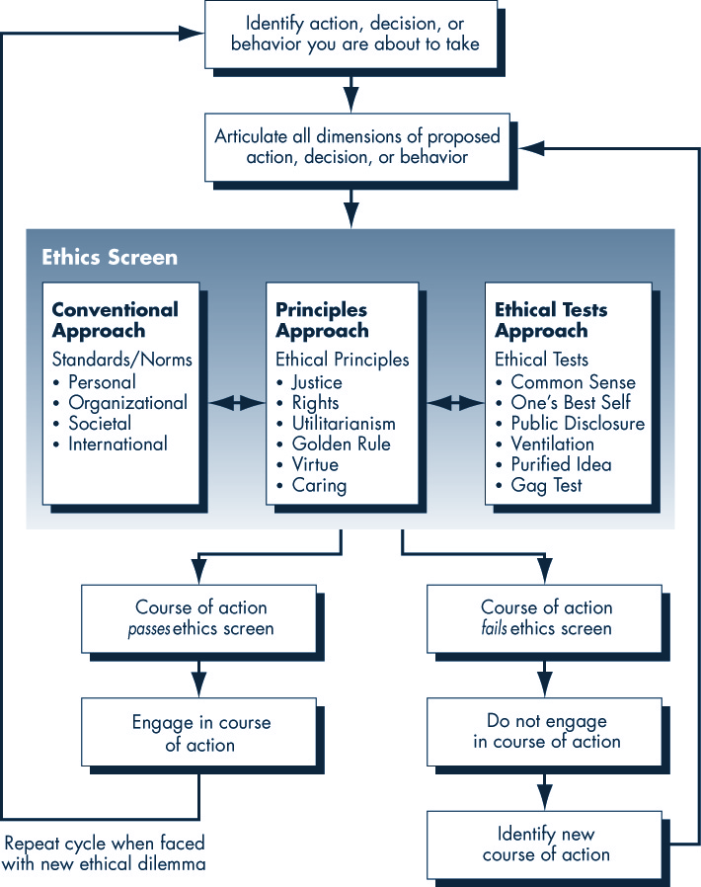
Ethical Decision-Making Process
0
Figure 8-9

Slide 36
Ethics Check
0
Is it legal?
Is it balanced?
How will it make me feel about myself?

Slide 37
Texas Instruments Ethics Quick Test
0
Is the action legal?
Does it comply with our values?
If you do it, will you feel bad?
How will it look in the newspaper?
If you know it’s wrong, don’t do it.
If you’re not sure, ask.
Keep asking until you get an answer.

Slide 38
Sears’ Guidelines
0
Is it legal?
Is it within Sears’ shared beliefs and policies?
Is it right / fair / appropriate?
Would I want everyone to know about this?
How will I feel about myself?

Slide 39
Benefits of Ethics Codes
0
Legal protection for the company
Increased company pride and loyalty
Increased consumer / public goodwill
Improved loss prevention
Reduced bribery and kickbacks
Improved product quality
Increased productivity

Slide 40
Content of Codes of Conduct
0
Employment practices
Employee, client, and vendor information
Public information / communications
Conflicts of interest
Relationships with vendors
Environmental issues
Ethical management practices
Political involvement

Slide 41
How Codes of Conduct Influence Behavior
0
Codes of Conduct act as a…
Rule book
Signpost
Mirror
Magnifying glass
Shield
Smoke detector
Fire alarm
Club

Slide 42
Purposes of Ethics Training
0
Increase the manager’s sensitivity to ethical problems
Encourage critical evaluation of value priorities
Increase awareness of organizational realities
Increase awareness of societal realities
Improve understanding of the importance of public image
Examine the ethical facets of business decision making
Bring about a greater degree of fairness and honesty in the workplace
Respond more completely to the organization’s social responsibilities

Slide 43
Corporate Transparency
A quality, characteristic, or state
in which activities, processes,
practices, and decisions that take
place in companies become open or
visible to the outside world.
0
Corporate
Transparency

Slide 44
Board of Director
Leadership and Oversight
0
The 2002 Sarbanes-Oxley Act
Companies are required to protect whistle-blowers without fear of retaliation
It is a crime to alter, destroy, conceal, cover up, or falsify documents to prevent its use in a federal government lawsuit

Slide 45
From Moral Decisions to
Moral Organizations
0
Moral Decisions
Moral Managers
Moral Organizations
Figure 8-10

Slide 46
Key Terms
0
Aretaic theories
Categorical imperative
Codes of conduct
Codes of ethics
Compensatory justice
Corporate transparency
Deontological theories
Distributive justice
Ethic of care
Ethical due process
Ethical tests
Ethics audits
Ethics officer
Ethics programs
Golden Rule
Legal rights
Moral rights
Negative right
Opacity
Positive right
Principle of justice
Principle of rights
Principle of utilitarianism
Procedural justice
Rights
Risk assessments
Servant leadership
Teleological theories
Transparency
Utilitarianism
Virtue ethics

